Slide 1

Presentation on
2 D.O.F Robotic Arm (Manipulator) Using Arduino
Submitted by-
Aman Kumar Arya (18564)
Shailendra Kumar Maurya (18550)
Vikas Kumar (18559)
Saurabh Mishra (18548)
Prasann Kumar Maurya (18537)
Under the supervision of :
DR. A.K CHAUHAN
( DEPARTMENT OF MECHANICAL ENGINEERING )
KAMLA NEHRU INSTITUTE OF TECHNOLOGY, SULTANPUR
(Affiliated to Dr A.P.J Abdul Kalam Technical University)

Slide 2
CONTENTS
INTRODUCTION
COMPONENTS
ARDIUNO PROGRAMING
CONSTRUCTION
CONNECTION
WORKING
CALCULATION
APPLICATION
FUTURE SCOPE

Slide 3
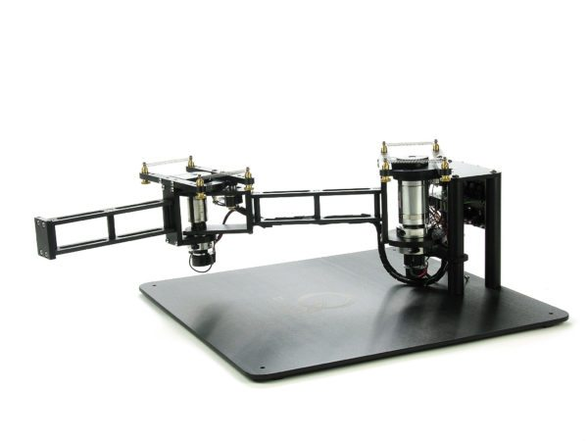
INTRODUCTION
A robotic arm is type of Mechanical arm, usually programmable, with similar functions to a human arm. The links of such a manipulator are connected by joints allowing either rotational motion or translational displacement. The links of manipulator can considered a kinematic chain.
The terminus of kinematic chain of manipulator is called end-effector and it is analogous to human hand.

Slide 4
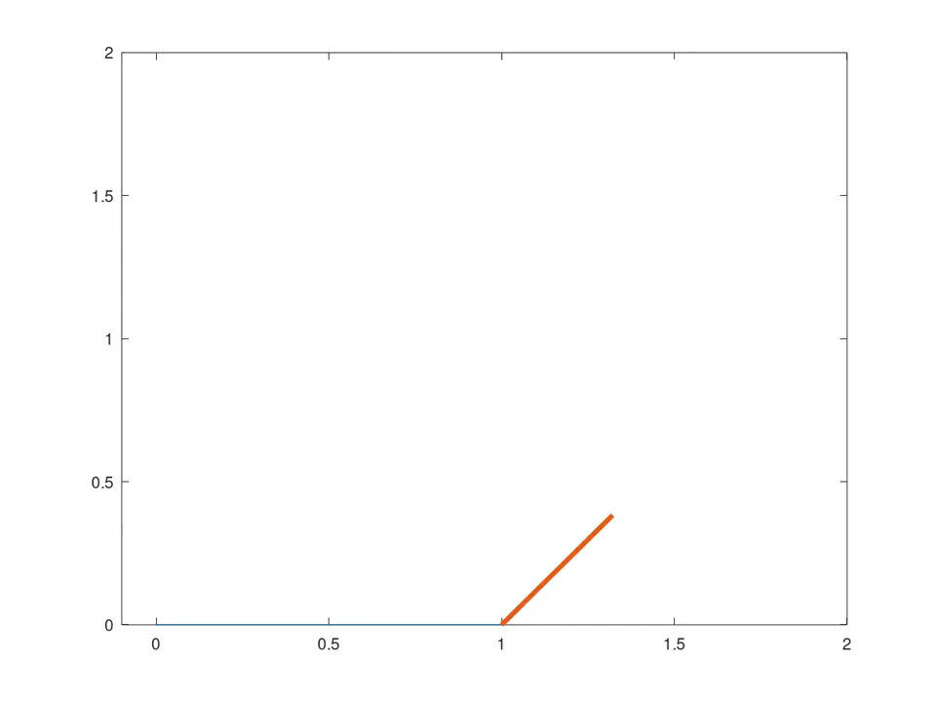

Slide 5
COMPONENTS
Arduino UNO Mega 2560
Breadboards
Servo Motors MG996R
Jumping Wires
Resistors
DC Power Supply (9V)
Screw Nuts

Slide 6
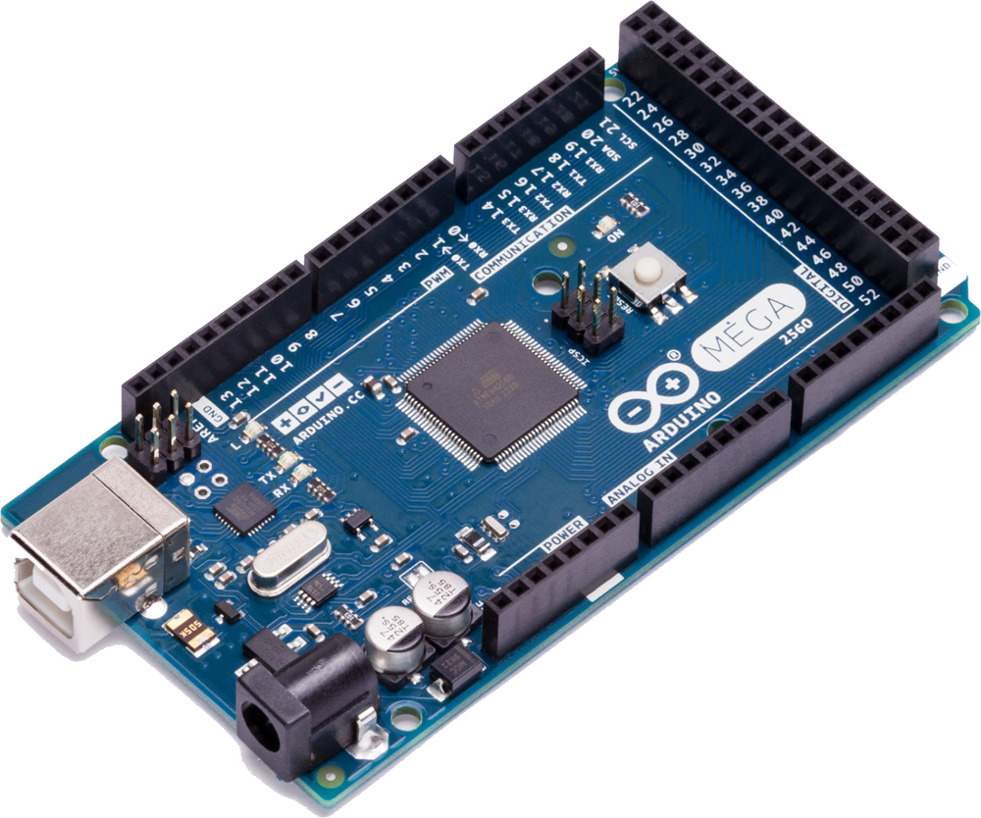
Arduino Mega(2560)
The Arduino Uno is an open-source microcontroller board based on the Microchip ATmega328P microcontroller and developed by Arduino.cc. The board is equipped with sets of digital and analog input/output pins that may be interfaced to various expansion boards and other circuits.

Slide 7
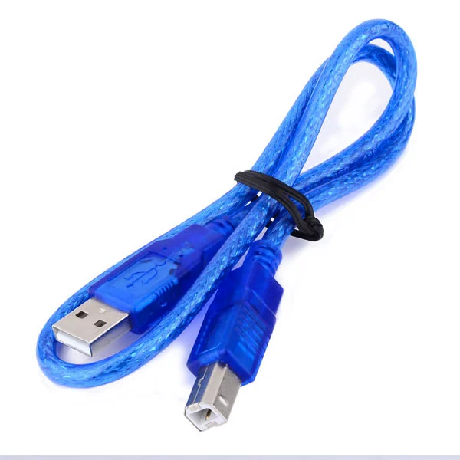
USB CABLE
The Arduino programming cable is used to program Arduino boards. It is needed to establish communication between the Arduino board and computer so that we can send and receive the data from the board and program it accordingly.

Slide 8
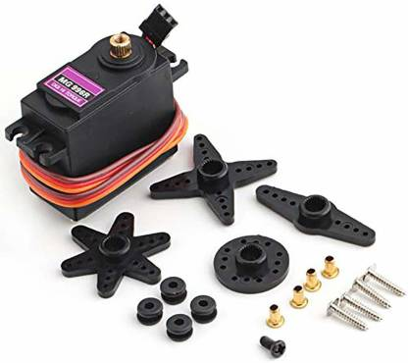
Servo MOtor
A servo motor is a rotary actuator that allows for precise control of angular position. It consists of a motor coupled to a sensor for position feedback. It also requires a servo drive to complete the system. The drive uses the feedback sensor to precisely control the rotary position of the motor.

Slide 9
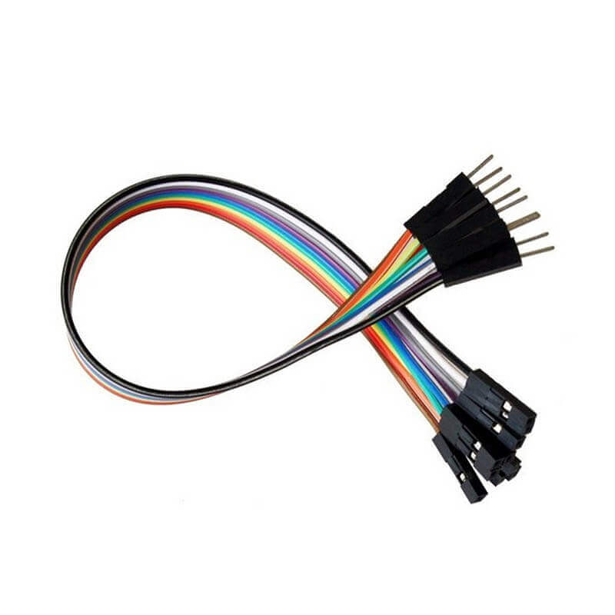
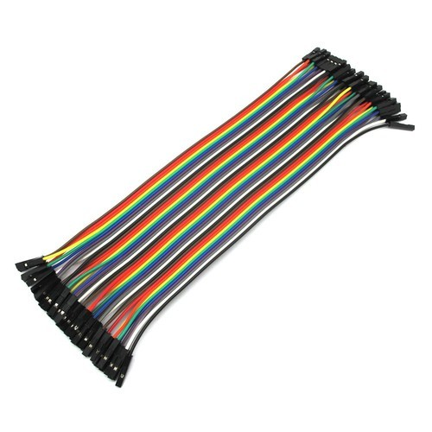
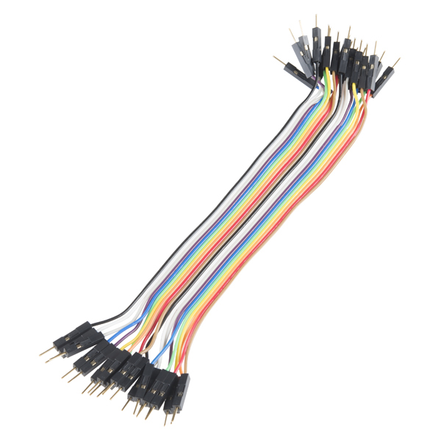
Jumper wires
Jumper wires are simply wires that have connector pins at each ends, allowing them to be used to connect two points to each other without soldering. Jumper wires are mainly used with breadboards and with other prototyping tools in order to make it easy to change a circuit as needed.
Male to Female
Male to Male

Slide 10
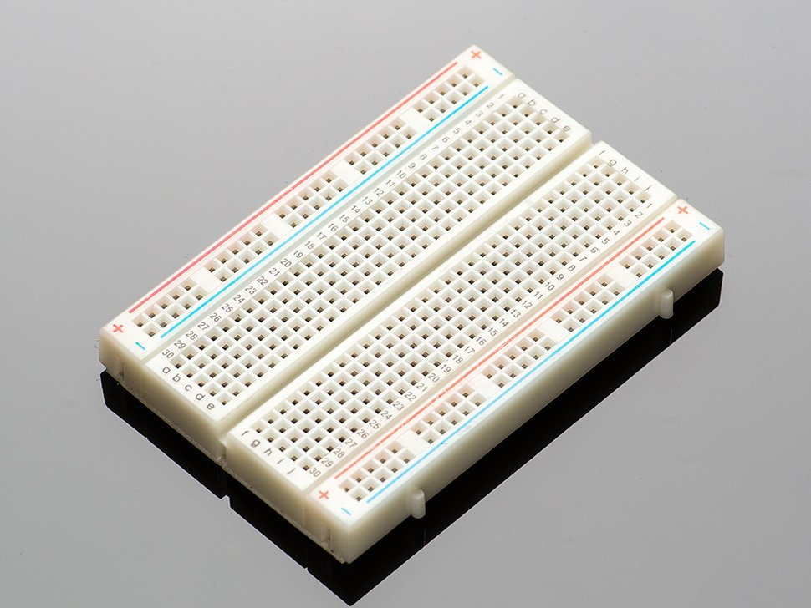
breadboard
Breadboard is a rectangular plastic board with a bunch of tiny holes in it.
A breadboard allows for easy and quick creation of temporary electronic circuits or to carry out experiments with circuit design.

Slide 11
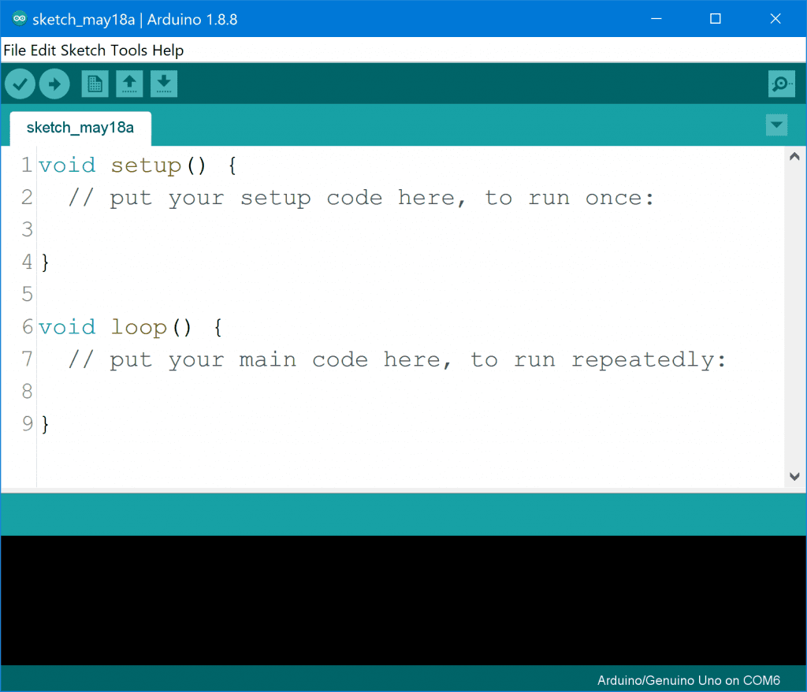
ARDUINO PROGRAM
To Program an Arduino, Firstly we need to install a software -Arduino Environment (IDE). After installing we connect our Arduino to computer/laptop. To program Arduino we write code on the IDE – verify it and upload it to Arduino. If any program is already uploaded or implemented then we can reset it using reset button on the Arduino board.

Slide 12
CONSTRUCTION
At first, Place the Servo Motor1 at centimeter board in the middle and fit it with help of screw or any other means so that it stays at same place.
After connecting servo horn with servo gear we connected first link(12 cm) on the top of servo horn.
At the end of the first link we attached Servo Motor2 .
After connecting Servo Motor2, we connect servo horn on gear of servo motor2 to connect the 2nd Link (8 cm).

Slide 13
CONNECTIONS
CONNECTING ARDUINO TO BREADBOARD
Using a jumper wire ( M to M type) connect the ground of Arduino to one of the vertically aligned pins of breadboard.
Using another jumper wire of same type we connected 5V supply of Arduino to another vertical pins (for supplying power to breadboard).

Slide 14
CONNECTING SERVO MOTORS WITH ARDUINO AND BREADBOARD
First we need to connect Brown wire of Servo Motors 1&2 with Ground terminal of Arduino so we should have to connect it with the ground circuit of breadboard.
Then we have to connect red wires of both motors to the 5V pin of Arduino so we connected it to breadboard pin with 5V supply from Arduino.
After that we connected yellow wires of motors (that carries command pulses) to the 11th and 3rd digital pins of Arduino directly.

Slide 15
working
The working of robotic arm depends upon the concept of forward and inverse kinematics.
In Forward Kinematics user have to input the values of length of arms and joint angles for rotation of robotic arm through which the position of robotic arm is obtained.
In inverse kinematics user have to input the position of robotic arm and joint variables(ϴ1,ϴ2) are obtained from giving position.
We need to give Input for our project, for that we have to use Serial Monitor where we give input several things like Length of Links, Forward Kinematics or Backward Kinematics and serial monitor will display the output according to the case.

Slide 16
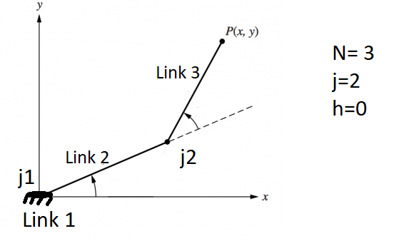
CALCULATIONS
DEGREE OF FREEDOM-:
Degree of Freedom (DoF) is an independent joint that can provide freedom of movement of the manipulator, either in a rotational or translational (linear) sense.
We can Calculate DoF by Kutzbach Equation:
DOF= 3(N-1)-2j-h
Where;
N= Number of Links
j = Number of Lower Pairs
h= Number of Higher Pairs

Slide 17
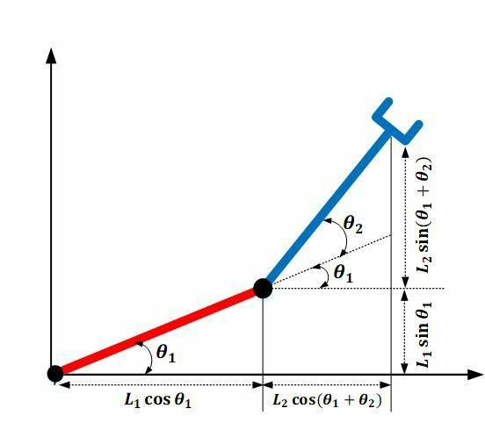

Forward Kinematics
To calculate position of end effector
$$x=L_{1}\cos{θ_{1}}+L_{2}\cos\left(θ_{1}+θ_{2}\right)$$
$$y=L_{1}\sin{θ_{1}}+L_{2}\sin\left(θ_{1}+θ_{2}\right)$$
Inverse Kinematics
To calculate the joint angles ($θ_{1}$ & $θ_{2}$)
$$θ_{2}=\cos^{−1}\left\{\frac{x^{2}+y^{2}−L_{1}^{2}−L_{2}^{2}}{2L_{1}L_{2}}\right\}$$
$θ_{1}=∅−θ_{2}$

Slide 18
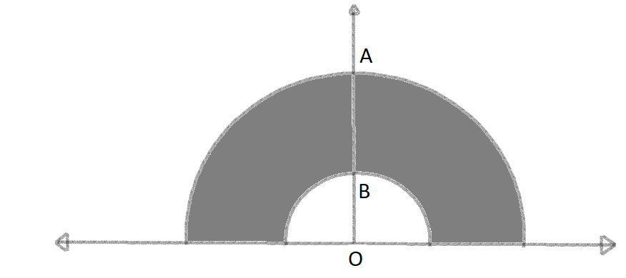
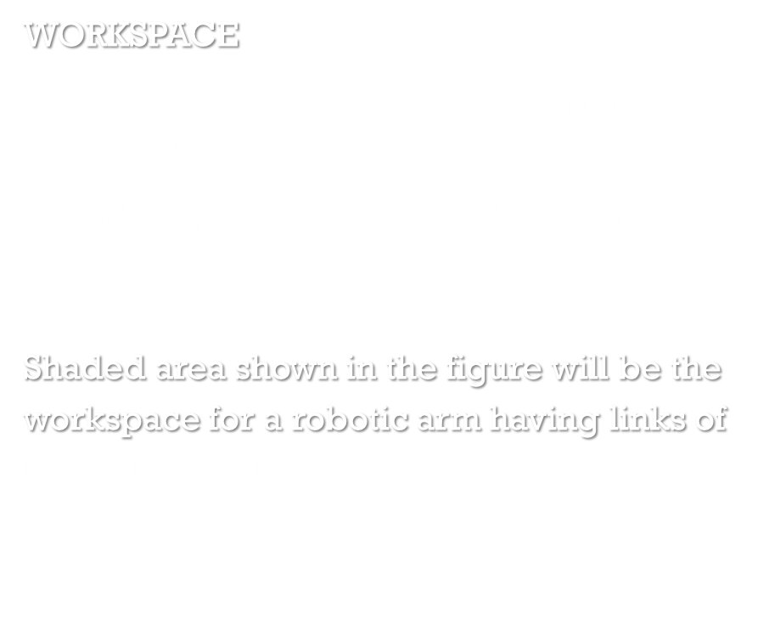
WORKSPACE
Area between the circles of Radius l₁+l₂ and l₁ – l₂ will be our workspace.
$x^{2}+y^{2}+{\left(l_{1}+l_{2}\right)}^{2}$< P (X,Y) <$x^{2}+y^{2}−{\left(l_{1}+l_{2}\right)}^{2}$
Shaded area shown in the figure will be the workspace for a robotic arm having links of l1 and l2 length.

Slide 19
APPLICATIONS
Robotic arm is used in various fields like in the industries, medical field, transportation etc.
Asssembly Line
Welding and Painting Operations
Material handeling
Loading – Unloading
Mechanical Cutting
Gluing, Adhesive Sealing and Spraying Materials

Slide 20
Future scope
The number of degrees of freedom of the robotic arm can be increased in order to expand its workspace, thereby making it more versatile.
Motors with higher torque ratings can be used to power the joints so as to ensure that the robotic arm remains in position even when electric current is not supplied to the motors.
Wireless control of the robotic arm using Bluetooth™ or Wi-Fi™ (IEEE 802.11x) technology can be implemented.
Object detection and collision avoidance can be implemented by adding proximity sensors to the robotic arm

Slide 21
THANK YOU

